Slide 1
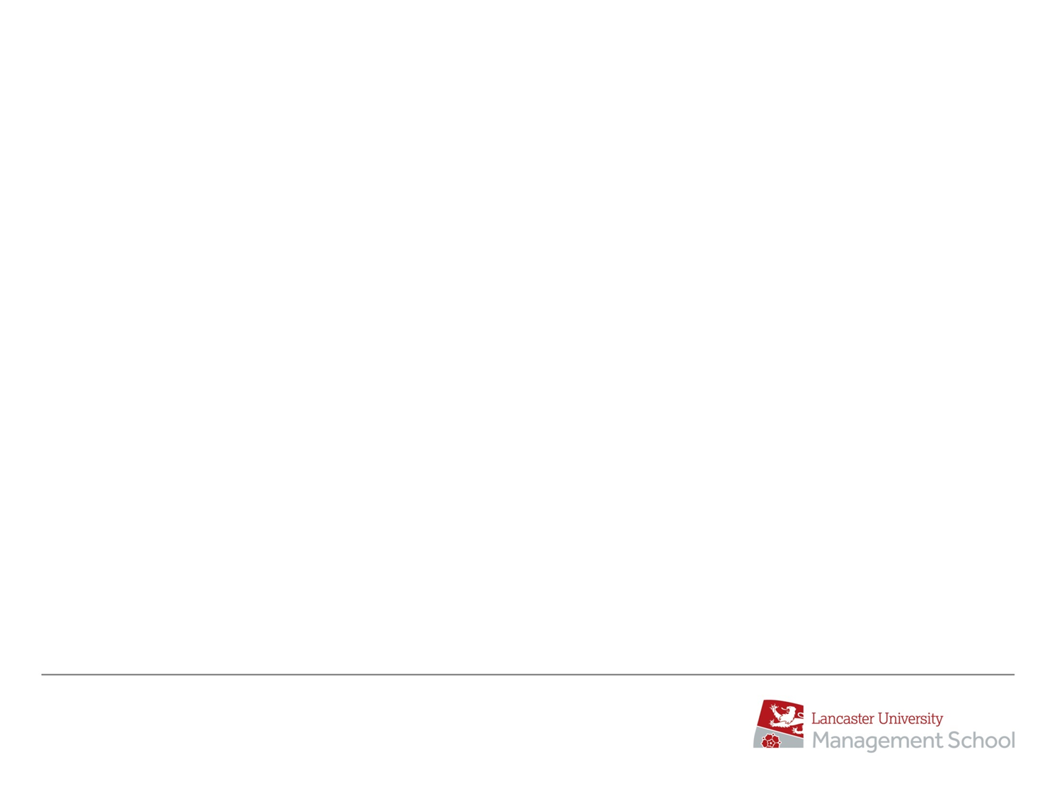


AcF 304 Financial Markets
Topic 6: The Money Markets
Part 3 – Money Markets in Practise
(Focussing on Interbank Deposits associated with FX)
Notes:
If this PowerPoint presentation contains mathematical equations, you may need to check that your computer has the following installed:
1) MathType Plugin
2) Math Player (free versions available)
3) NVDA Reader (free versions available)

Slide 2
Definition: Deposit Market
A wholesale market for the borrowing and lending of money
The period of time normally ranges from overnight up to 1 year
What are the Deposit?
Short dates
ON TN SN SW
Fixed Dates
1M 2M 3M 6M 9M 1Y
Apply to both Deposits and FX Forwards

Slide 3
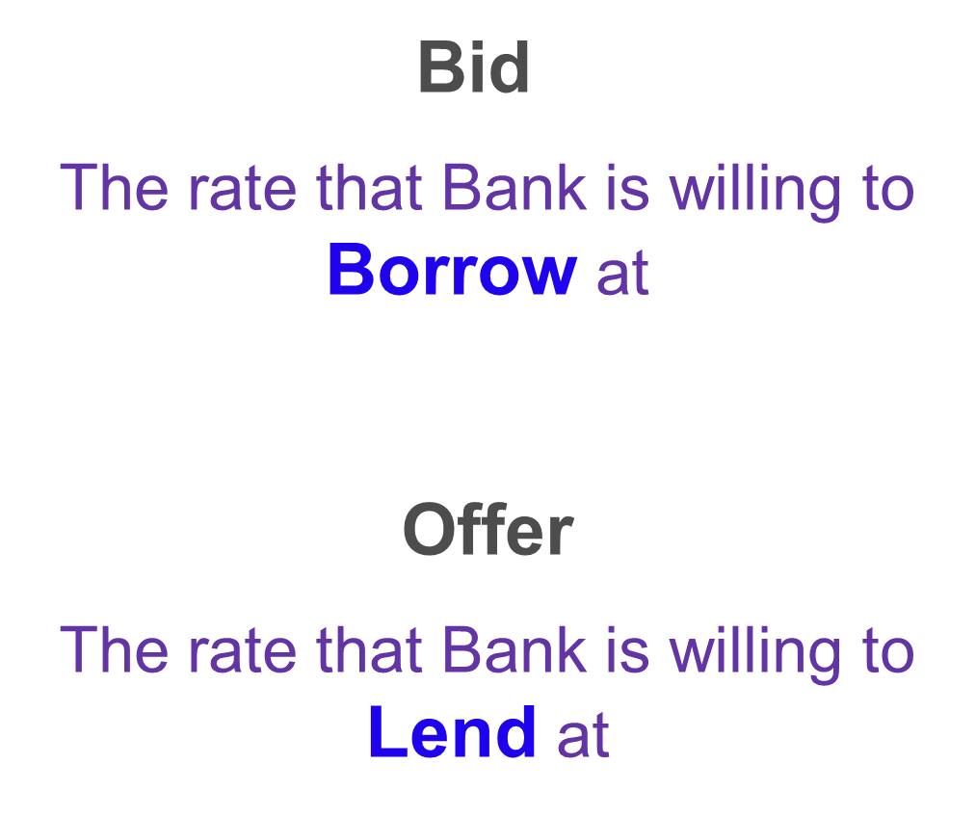
Bid & Offer – Again!
Periods
O/N
T/N
S/N
S/W
1M
2M
3M
6M
9M
1Y
3M 2.25% - 2.40%
Notes:
Loans are assets
Deposits are liabilities

Slide 4
Bid & Offer – Again!
3M 2.25% - 2.40%
Periods
O/N
T/N
S/N
S/W
1M
2M
3M
6M
9M
1Y
You the Client /Fund Manager
You lend funds at the BID 2.25%
You borrow funds at the OFFER 2.40%
Remember buying / selling the Toyota car!
Notes:
Loans are assets
Deposits are liabilities

Slide 5
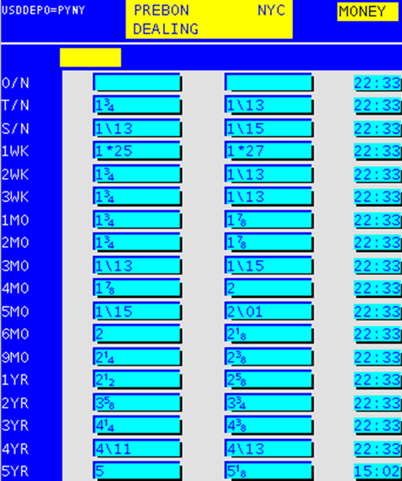
Thomson Reuters Deposit Data
Primarily OTC
Contributed by:
Banks and Brokers

Slide 6
DEPOSITS – Simple Interest
Not compounded
No collateral
Interest = Amount x Rate x No. of Days
Day Basis x 100
e.g.
10,000,000 x 1.82 x 90
360 x 100
=45,500

Slide 7
Question
Four banks are quoting these prices. From which bank would you borrow and which would you lend to?
a) 2 9/16 - 2 5/8%
b) 2 5/8 - 2 11/16%
c) 2 9/16 - 2 13/16%
d) 2 1 /2 - 2 9/16%
a) 2 9/16 - 2 5/8%
b) 2 5/8 - 2 11/16% Lend
c) 2 9/16 - 2 13/16%
d) 2 1 /2 - 2 9/16% Borrow

Slide 8
Need a Fix?
London Interbank Offered Rate
https://www.investopedia.com/terms/l/libor.asp
LIBOR
Used for Fixing Loans, FRAs, Interest Rate Swaps
All major currencies
EURIBOR, TIBOR, HIBOR etc..

Slide 9
LIBOR- London Interbank Offered Rate
Rates polled at 11 AM (London Time)
Fixed by ICE
16 Banks Polled –Average of Mid
Notes:
LIBOR is tracked by aome $370 Trilion of financial products
From mortgages to complex derivatives.
Companies and traders are scrambling to prepare for the demise of this scandal-plagued interest benchmark.
Market participanst will swicth to another reference rate.
LIBOR could disappera by 2021 when regulators no longer force banks to continue supporting the benchmark.
The process of shifting trillions of dolars to new rate sis expected to be complicated.
In the UK sterling LIBOR contracts total more than $30 Trillion- 11 times the size of the economy.
LIBOR is set daily as an average of rates submitted by global banks but many banks have been unwilling to participate since the discovery in 2012 that some of the largest bank’s manipulated LIBOR for ther own profit.
The key issue with switching to a differnet so-caled risk fre rate was thatthese generally have an overnight–term while LIBOR benchmarks spanned at least a few months. In the UK the Financial Conduct Authority and BoWE are attempting to encourage a switch to the Sterling Overnight Index Average.
Another crucial issue is that LIBOR . A sthe rate that banks lend to each other, entails credit risk, whereas overnight rates (almost) do not.

Slide 10

LIBOR- Scandal
https://www.ft.com/content/2a4479f8-c030-11e1-9867-00144feabdc0
Notes:
LIBOR is tracked by aome $370 Trilion of financial products
From mortgages to complex derivatives.
Companies and traders are scrambling to prepare for the demise of this scandal-plagued interest benchmark.
Market participanst will swicth to another reference rate.
LIBOR could disappera by 2021 when regulators no longer force banks to continue supporting the benchmark.
The process of shifting trillions of dolars to new rate sis expected to be complicated.
In the UK sterling LIBOR contracts total more than $30 Trillion- 11 times the size of the economy.
LIBOR is set daily as an average of rates submitted by global banks but many banks have been unwilling to participate since the discovery in 2012 that some of the largest bank’s manipulated LIBOR for ther own profit.
The key issue with switching to a differnet so-caled risk fre rate was thatthese generally have an overnight–term while LIBOR benchmarks spanned at least a few months. In the UK the Financial Conduct Authority and BoWE are attempting to encourage a switch to the Sterling Overnight Index Average.
Another crucial issue is that LIBOR . A sthe rate that banks lend to each other, entails credit risk, whereas overnight rates (almost) do not.

Slide 11

LIBOR- London Interbank Offered Rate
https://www.ft.com/content/fc43c6c4-1fe8-11e9-b2f7-97e4dbd3580d
Notes:
LIBOR is tracked by aome $370 Trilion of financial products
From mortgages to complex derivatives.
Companies and traders are scrambling to prepare for the demise of this scandal-plagued interest benchmark.
Market participanst will swicth to another reference rate.
LIBOR could disappera by 2021 when regulators no longer force banks to continue supporting the benchmark.
The process of shifting trillions of dolars to new rate sis expected to be complicated.
In the UK sterling LIBOR contracts total more than $30 Trillion- 11 times the size of the economy.
LIBOR is set daily as an average of rates submitted by global banks but many banks have been unwilling to participate since the discovery in 2012 that some of the largest bank’s manipulated LIBOR for ther own profit.
The key issue with switching to a differnet so-caled risk fre rate was thatthese generally have an overnight–term while LIBOR benchmarks spanned at least a few months. In the UK the Financial Conduct Authority and BoWE are attempting to encourage a switch to the Sterling Overnight Index Average.
Another crucial issue is that LIBOR . A sthe rate that banks lend to each other, entails credit risk, whereas overnight rates (almost) do not.

Slide 12
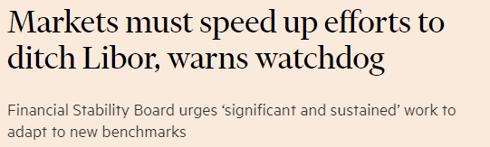
LIBOR- London Interbank Offered Rate
https://www.ft.com/content/e80bc170-217c-11ea-b8a1-584213ee7b2b
Notes:
LIBOR is tracked by aome $370 Trilion of financial products
From mortgages to complex derivatives.
Companies and traders are scrambling to prepare for the demise of this scandal-plagued interest benchmark.
Market participanst will swicth to another reference rate.
LIBOR could disappera by 2021 when regulators no longer force banks to continue supporting the benchmark.
The process of shifting trillions of dolars to new rate sis expected to be complicated.
In the UK sterling LIBOR contracts total more than $30 Trillion- 11 times the size of the economy.
LIBOR is set daily as an average of rates submitted by global banks but many banks have been unwilling to participate since the discovery in 2012 that some of the largest bank’s manipulated LIBOR for ther own profit.
The key issue with switching to a differnet so-caled risk fre rate was thatthese generally have an overnight–term while LIBOR benchmarks spanned at least a few months. In the UK the Financial Conduct Authority and BoWE are attempting to encourage a switch to the Sterling Overnight Index Average.
Another crucial issue is that LIBOR . A sthe rate that banks lend to each other, entails credit risk, whereas overnight rates (almost) do not.

Slide 13
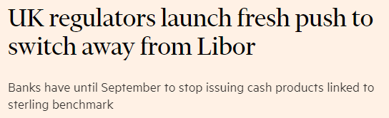
LIBOR- London Interbank Offered Rate
https://www.ft.com/content/8c57ae5e-3840-11ea-a6d3-9a26f8c3cba4
Notes:
LIBOR is tracked by aome $370 Trilion of financial products
From mortgages to complex derivatives.
Companies and traders are scrambling to prepare for the demise of this scandal-plagued interest benchmark.
Market participanst will swicth to another reference rate.
LIBOR could disappera by 2021 when regulators no longer force banks to continue supporting the benchmark.
The process of shifting trillions of dolars to new rate sis expected to be complicated.
In the UK sterling LIBOR contracts total more than $30 Trillion- 11 times the size of the economy.
LIBOR is set daily as an average of rates submitted by global banks but many banks have been unwilling to participate since the discovery in 2012 that some of the largest bank’s manipulated LIBOR for ther own profit.
The key issue with switching to a differnet so-caled risk fre rate was thatthese generally have an overnight–term while LIBOR benchmarks spanned at least a few months. In the UK the Financial Conduct Authority and BoWE are attempting to encourage a switch to the Sterling Overnight Index Average.
Another crucial issue is that LIBOR . A sthe rate that banks lend to each other, entails credit risk, whereas overnight rates (almost) do not.

Slide 14
EURIBOR- Euro Interbank Offered Rate
Rates polled at 11 AM (Brussels Time)
Approx 50 Banks Polled –Average of All
Note:EURIBOR can be 360 OR 365 Day Basis

Slide 15
Taking a View
Speculating on the future direction of Interest Rates e.g. Fall
Lend money at 4.75 %
Wait for rates to fall
%
Borrow the money back at 4.5%
Lock in 0.25% profit.
=
Notes:
The role Money Market dealer therefore can be broken down into two functions - the first squaring the banks position each day. The first is the funding of these long or short positions each day. The second function is speculation with this money and also, of course, money you haven't got.
(Please note that the concept of speculation and trading will be covered in the INTRO - so this should be repetition now.)

Slide 16
AcF 304 Financial Markets
Topic 6: The Money Markets
Part 4 – A Day in the Life of a Trader
Notes:
If this PowerPoint presentation contains mathematical equations, you may need to check that your computer has the following installed:
1) MathType Plugin
2) Math Player (free versions available)
3) NVDA Reader (free versions available)

